Slide 1

SMART HOME

Slide 2
Created by :
Elhosseni Gamal Nour Eldeen
Ammar Abd El-hady Aly

Slide 3
SMART HOME
a mini embedded system project by using ATmega32 (AVR) , it consist of sub concepts and drivers like (GPIO, ADC, Communication Protocol "SPI" , Interrupts "timer interrupt“ , EEPROM, LCD, Keypad)

Slide 4
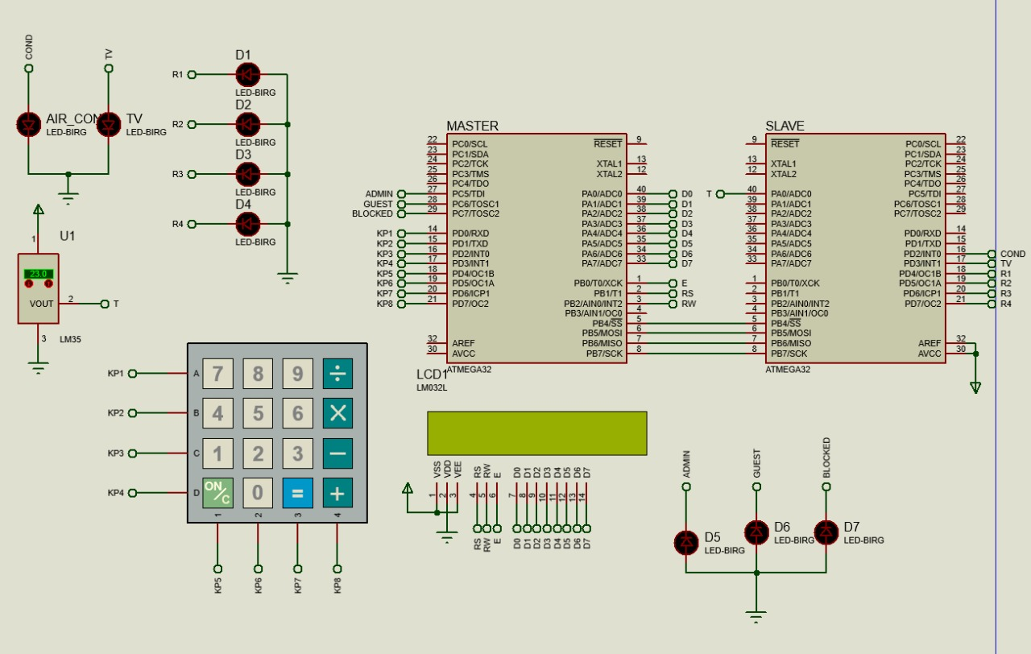

Slide 5
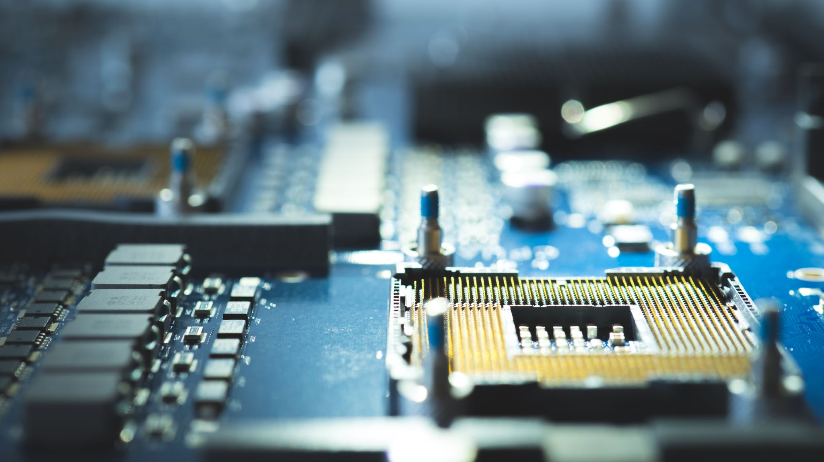
System components

Slide 6
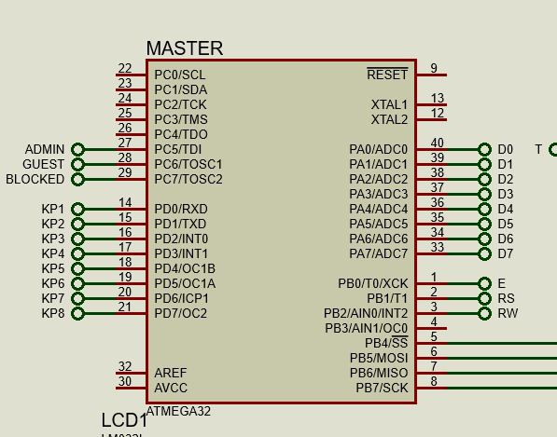
Master

Slide 7
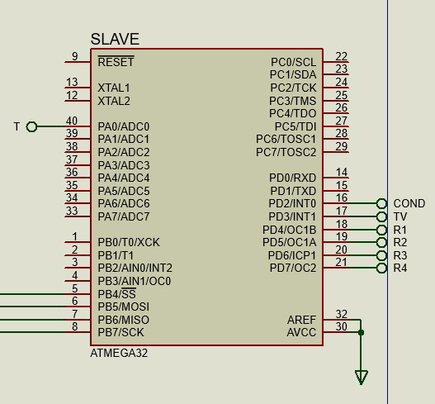
Slave

Slide 8
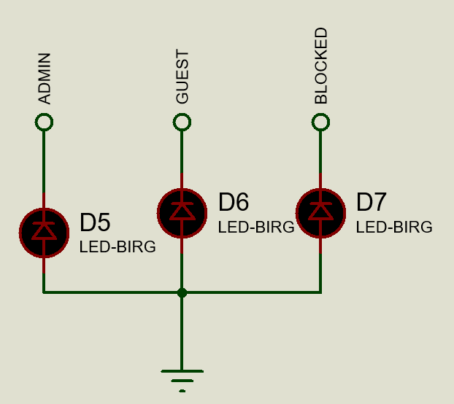
Operation Modes

Slide 9
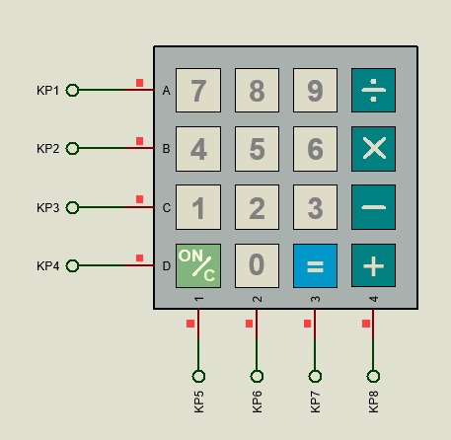
KeyPad

Slide 10
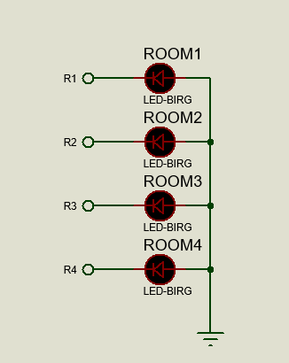
Rooms

Slide 11
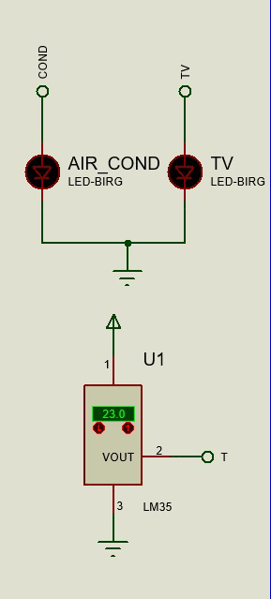
Air condition
TV
LM - 35

Slide 12
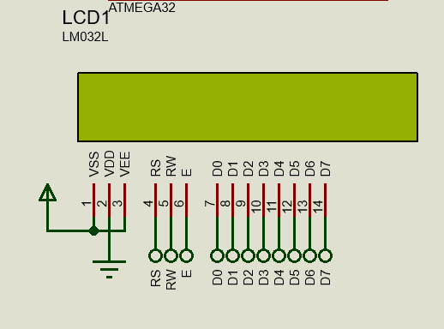
LCD

Slide 13
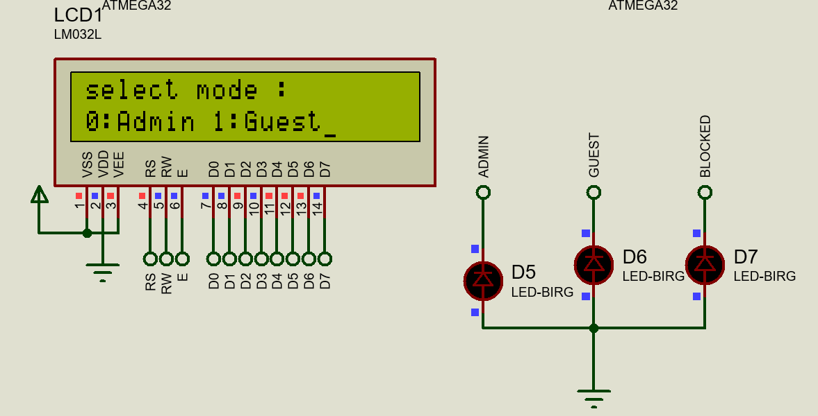
Mode Selection

Slide 14
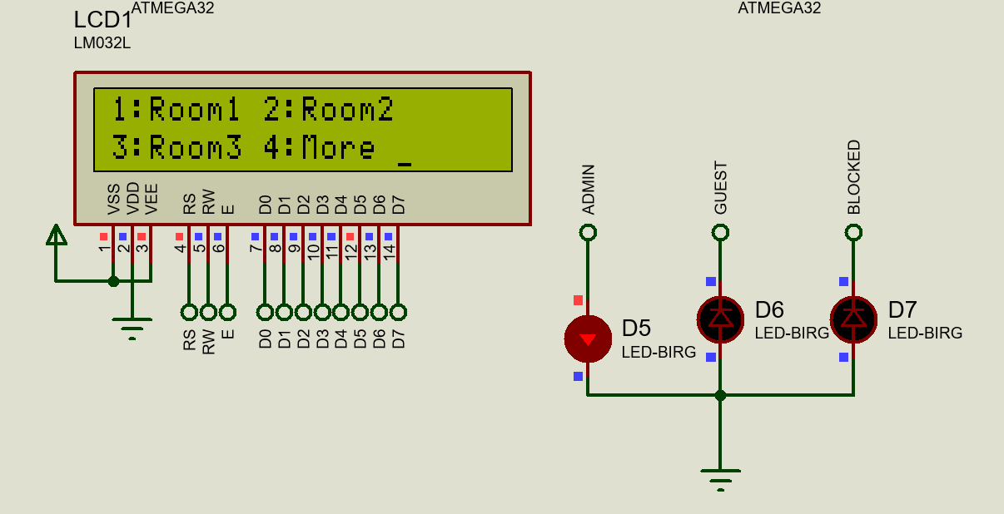
Admin Mode

Slide 15
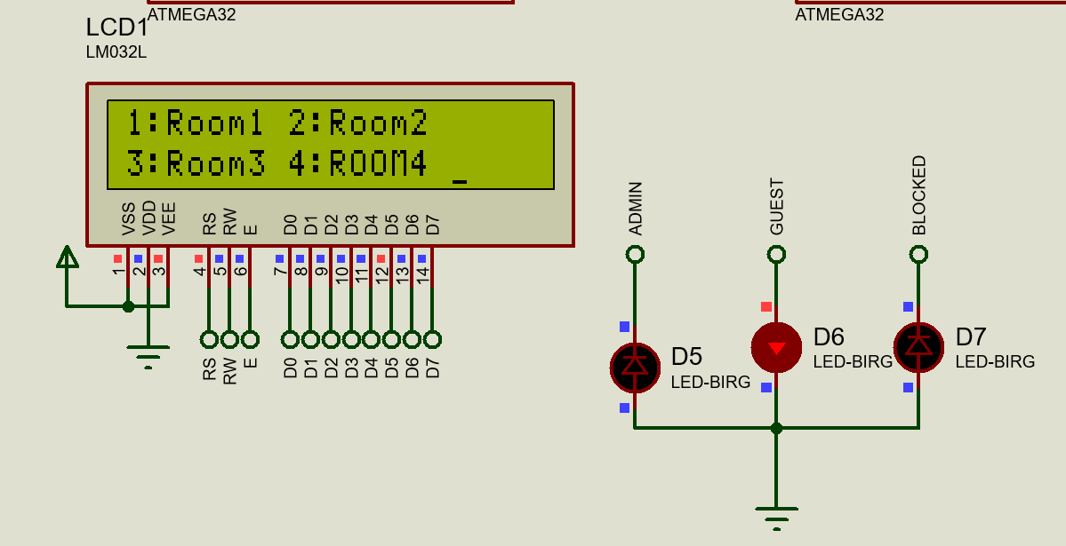
Guest Mode

Slide 16
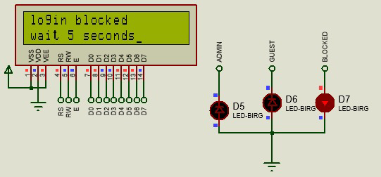
Blocked Mode it activated when you entered password wrong for three times

Slide 17
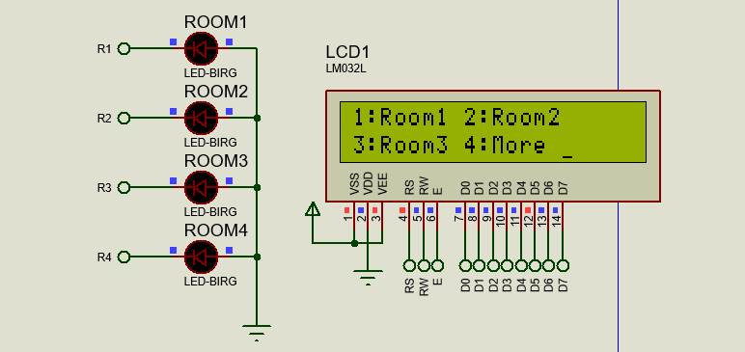
Admin mode options

Slide 18
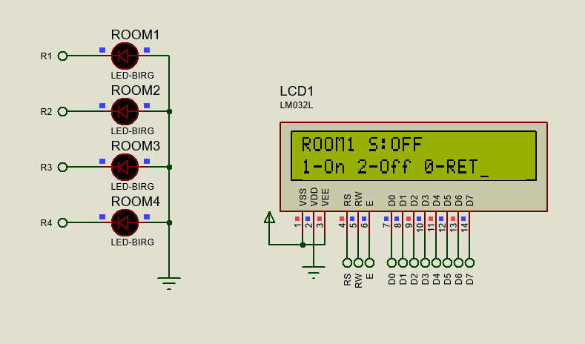
In Admin Mode :
Room1 State : Off
Select 1 : for turn on
Select 2 : for turn off
Select 0 : for return to main menu

Slide 19
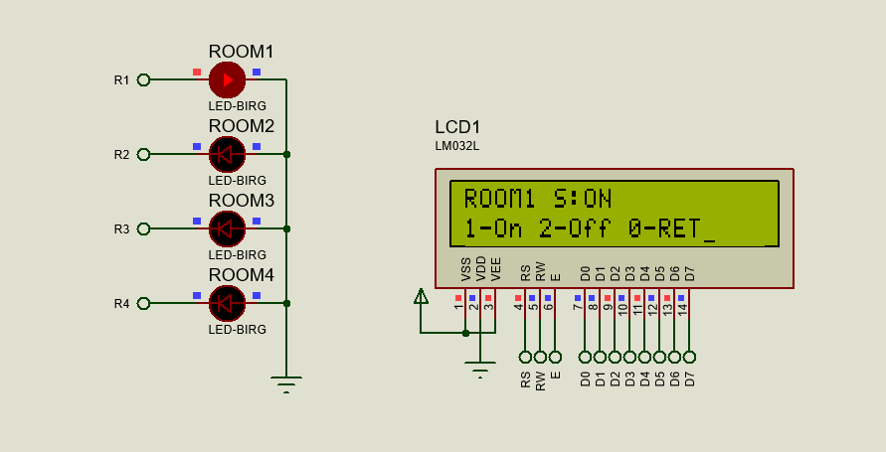
In Admin Mode :
Room1 State : on
Select 1 : for turn on
Select 2 : for turn off
Select 0 : for return to main menu

Slide 20
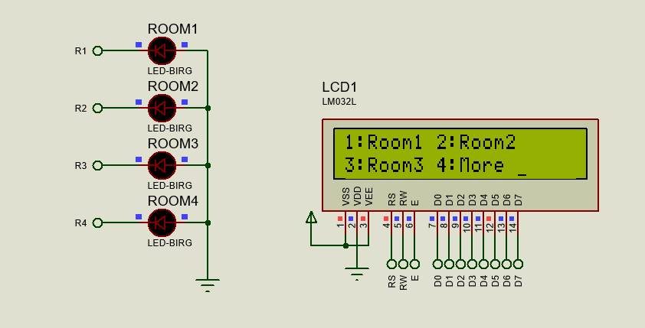
In Admin Mode :
For more option : 4

Slide 21
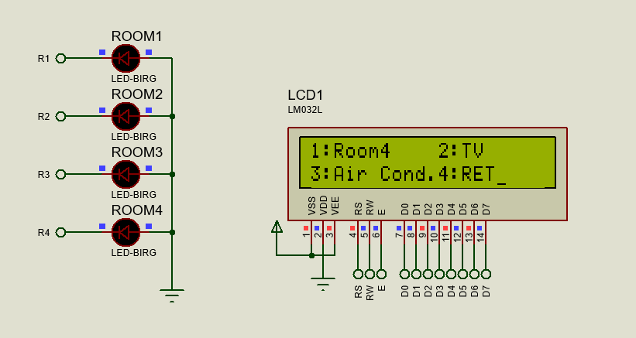
In Admin Mode :
more option

Slide 22
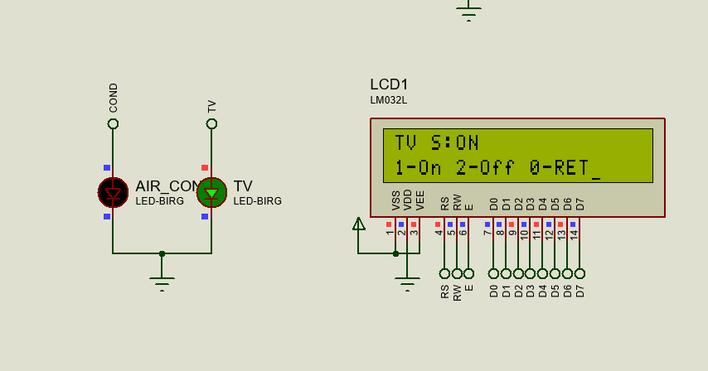
In Admin Mode :
Select 4 : for more
In more menu : select 2 for TV menu
In TV menu : 1 for turn on

Slide 23
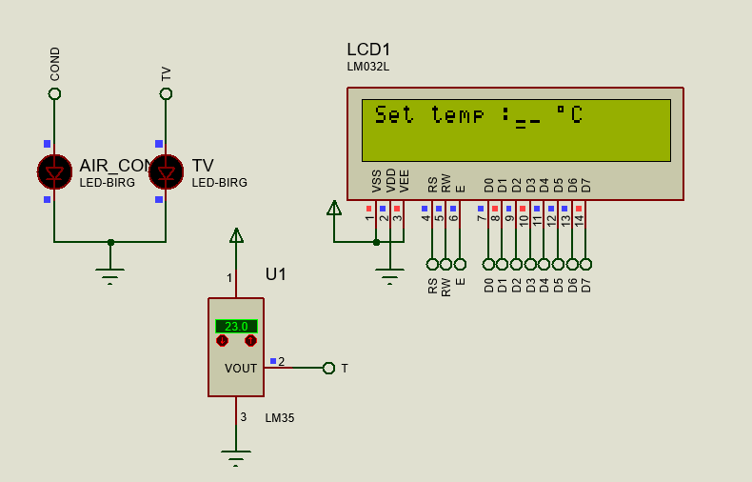
In Admin Mode :
Select 4 : for more
In more menu : select 1 for
Air con menu
In Air con menu : 1 for set a new temp

Slide 24
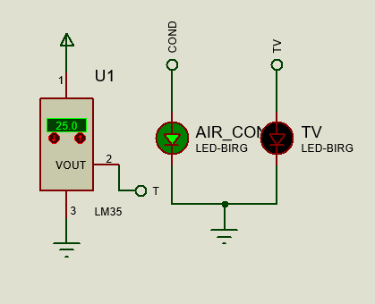
Air con will turn on automatically when temperature reaches 25 C
25 C is set by code and you are able to change it in run time

Slide 25
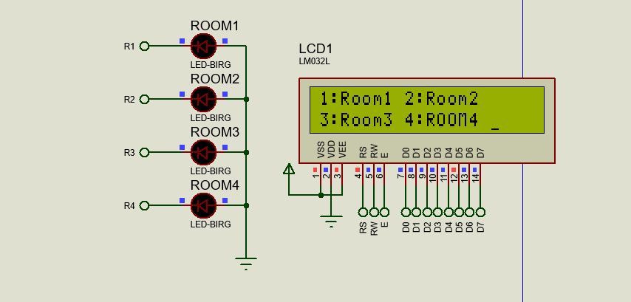
Guest mode options :
  The same option of admin mode expected air con and TV operations

Slide 26
THANKS..

